Slide 1
Examining
Numerical Data
Slides developed by Mine Çetinkaya-Rundel of OpenIntro
The slides may be copied, edited, and/or shared via the CC BY-SA license
Some images may be included under fair use guidelines (educational purposes)

Slide 2
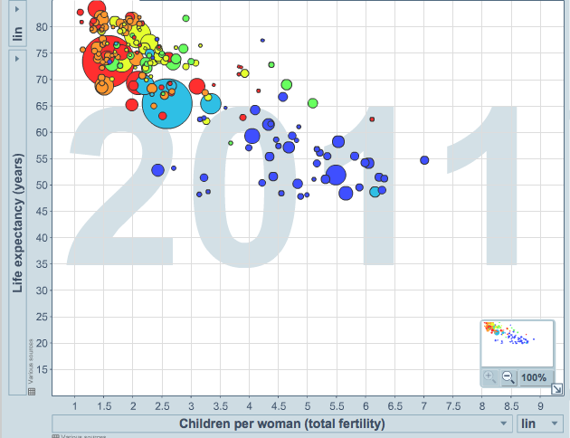
Scatterplot
Scatterplots are useful for visualizing the relationship between two numerical variables.
Do life expectancy and total fertility
appear to be associated or independent?
Was the relationship the same throughout
the years, or did it change?
They appear to be linearly and negatively associated: as fertility increases, life expectancy decreases.
The relationship changed over the years.
http://www.gapminder.org/world

Slide 3

Mean
The sample mean, denoted as x̄, can be calculated as
where x₁, x₂, ..., x_{n} represent the n observed values.
The population mean is also computed the same way but is denoted as µ. It is often not possible to calculate µ since population data are rarely available.
The sample mean is a sample statistic, and serves as a
point estimate of the population mean. This estimate may not be perfect, but if the sample is good (representative of the population),
it is usually a pretty good estimate.

Slide 4
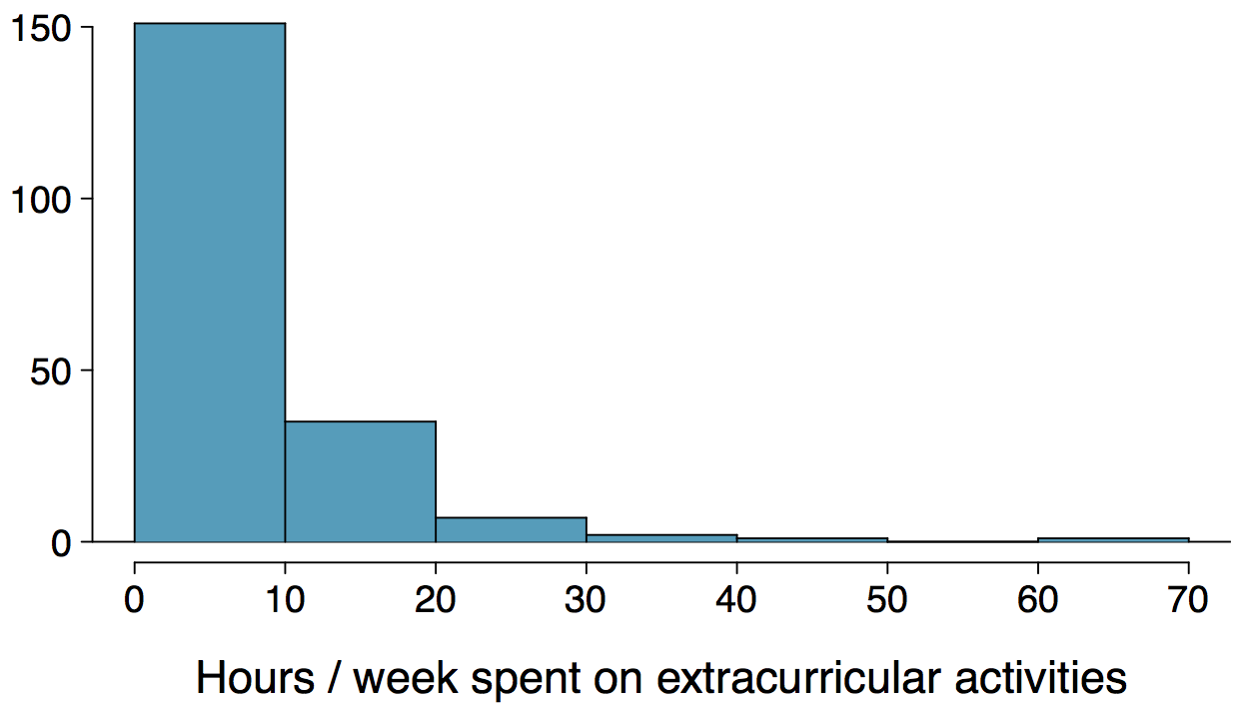
Histograms - Extracurricular Hours
Histograms provide a view of the data density. Higher bars represent where the data are relatively more common.
Histograms are especially convenient for describing the shape of the data distribution.
The chosen bin width can alter the story the histogram is telling.

Slide 5
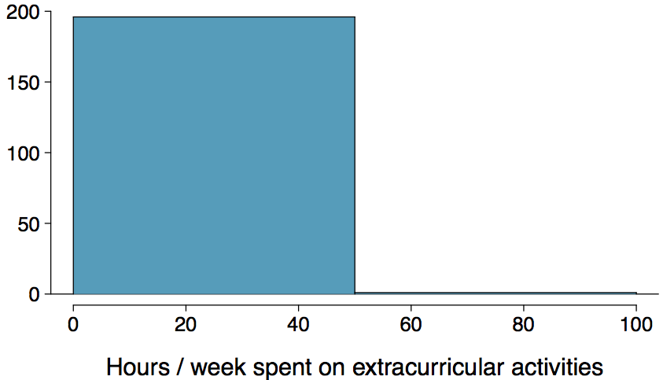
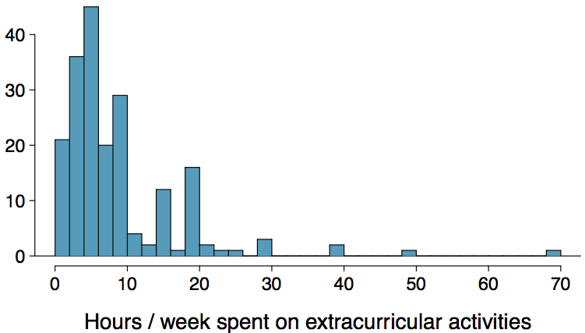
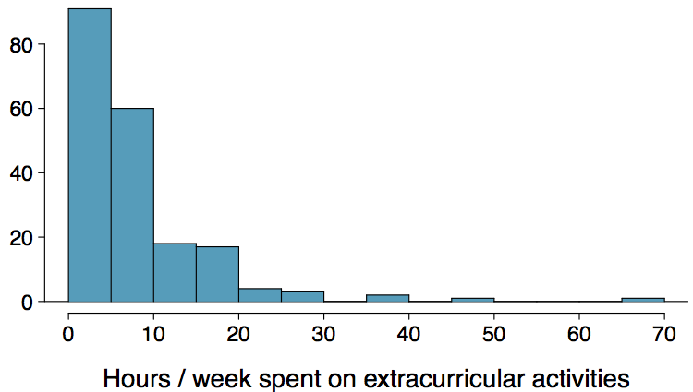
Bin Width
Which one(s) of these histograms are useful? Which reveal too much about the data? Which hide too much?

Slide 6
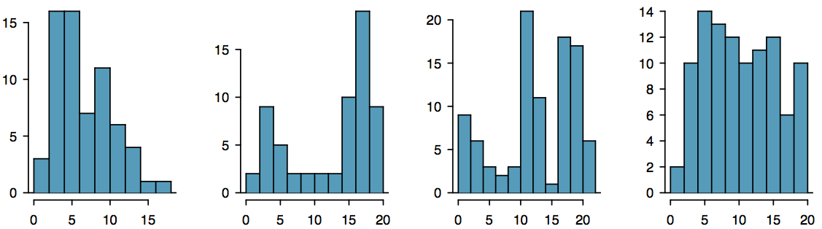
Shape of a Distribution: Modality
Does the histogram have a single prominent peak (unimodal), several prominent peaks (bimodal/multimodal), or no apparent peaks (uniform)?
Note: In order to determine modality, step back and imagine a smooth curve over the histogram -- imagine that the bars are wooden blocks and you drop a limp spaghetti over them, the shape the spaghetti would take could be viewed as a smooth curve.

Slide 7
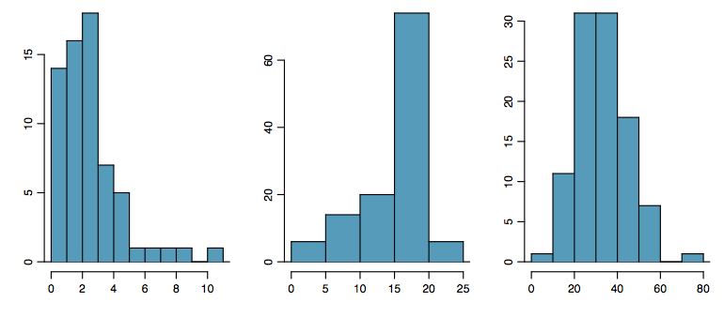
Shape of a Distribution: Skewness
Is the histogram right skewed, left skewed, or symmetric?
Histograms are said to be skewed to the side of the long tail.

Slide 8
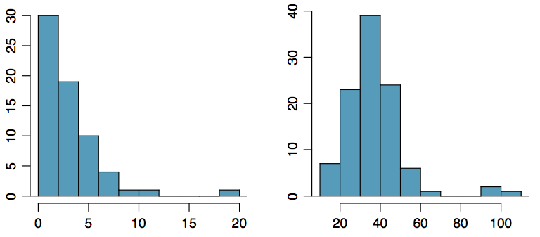
Shape of a Distribution:
Unusual Observations
Are there any unusual observations or potential outliers?

Slide 9
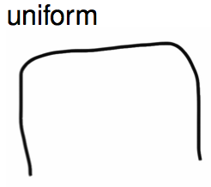
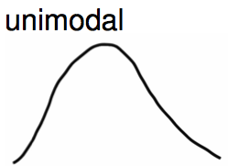
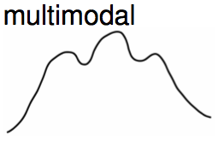
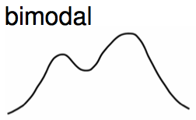
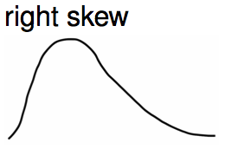
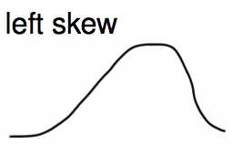
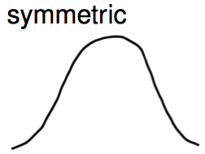
Commonly observed shapes of distributions
Modality
Skewness

Slide 10


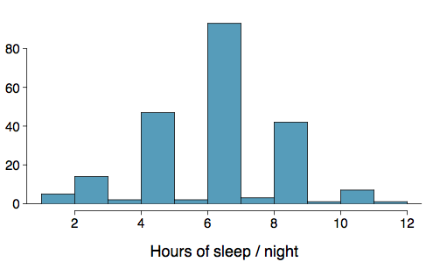
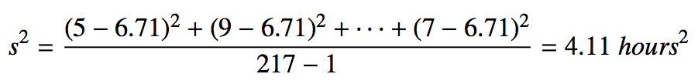
Variance
Variance is roughly the average squared deviation from the mean.
The sample mean is
and the sample size is n = 217.
The variance of amount of sleep
students get per night can be
calculated as:

Slide 11
Variance (cont.)
Why do we use the squared deviation in the calculation of variance?
To get rid of negatives so that observations equally distant from the mean are weighed equally.
To weigh larger deviations more heavily.

Slide 12

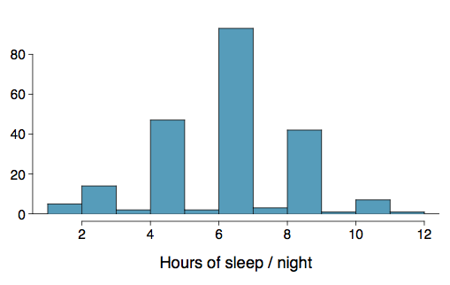

Standard Deviation
The standard deviation is the square root of the variance, and has the same units as the data.
The standard deviation of amount of sleep students get per night can be calculated as:
We can see that all of the data are within 3 standard deviations of the mean.

Slide 13

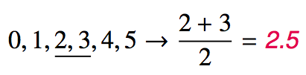
Median
The median is the value that splits the data in half when ordered in ascending order.
If there are an even number of observations, then the median is the average of the two values in the middle.
Since the median is the midpoint of the data, 50% of the values are below it. Hence, it is also the 50th percentile.

Slide 14
Q1, Q3, and IQR
The 25th percentile is also called the first quartile, Q1.
The 50th percentile is also called the median.
The 75th percentile is also called the third quartile, Q3.
Between Q1 and Q3 is the middle 50% of the data. The range these data span is called the interquartile range, or the IQR.
IQR = Q3 - Q1

Slide 15
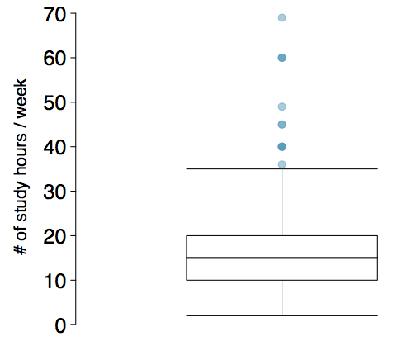
Box Plot
The box in a box plot represents the middle 50% of the data, and the thick line in the box is the median.

Slide 16
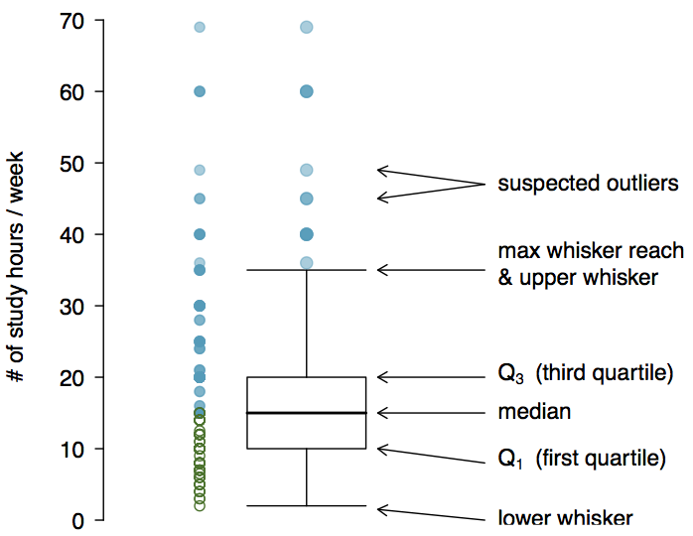
Anatomy of a Box Plot

Slide 17
Whiskers and Outliers
Whiskers of a box plot can extend up to 1.5 x IQR away from the quartiles.
max upper whisker reach = Q3 + 1.5 x IQR
max lower whisker reach = Q1 - 1.5 x IQR
IQR: 20 - 10 = 10
max upper whisker reach = 20 + 1.5 x 10 = 35
max lower whisker reach = 10 - 1.5 x 10 = -5
A potential outlier is defined as an observation beyond the maximum reach of the whiskers. It is an observation that appears extreme relative to the rest of the data.

Slide 18
Outliers (cont.)
Why is it important to look for outliers?
Identify extreme skew in the distribution.
Identify data collection and entry errors.
Provide insight into interesting features of the data.

Slide 19
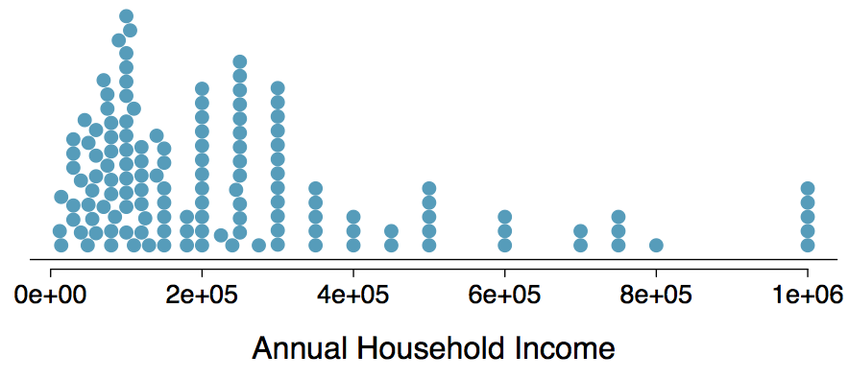
Extreme Observations
How would sample statistics such as mean, median, SD, and IQR of household income be affected if the largest value was replaced with $10 million? What if the smallest value was replaced with $10 million?

Slide 20
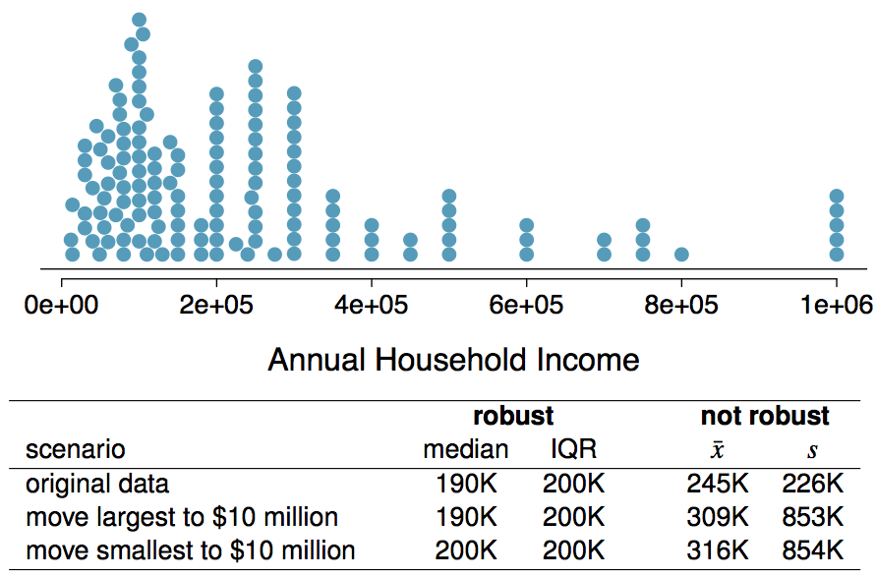
Robust Statistics

Slide 21
Robust Statistics
Median and IQR are more robust to skewness and outliers than mean and SD. Therefore,
for skewed distributions it is often more helpful to use median and IQR to describe the center and spread
for symmetric distributions it is often more helpful to use the mean and SD to describe the center and spread
If you would like to estimate the typical household income for a student, would you be more interested in the mean or median income?
Median

Slide 22
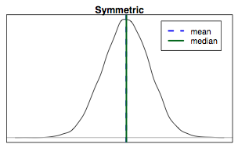
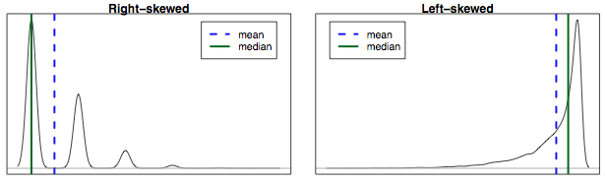
Mean vs. Median
If the distribution is symmetric, center is often defined as the mean:
mean ~ median
If the distribution is skewed or has extreme outliers, center is often defined as the median
Right-skewed: mean > median
Left-skewed: mean < median

